Slide 1
CSS INHERITANCE
Inheritance is when we declare something on an element, and it also applies that element’s decendant

Slide 2
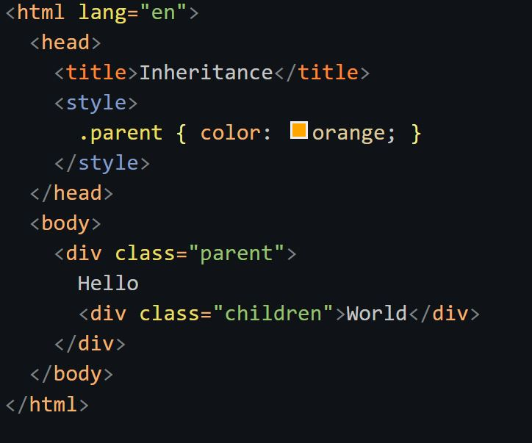
Will “inherite” the color

Slide 3
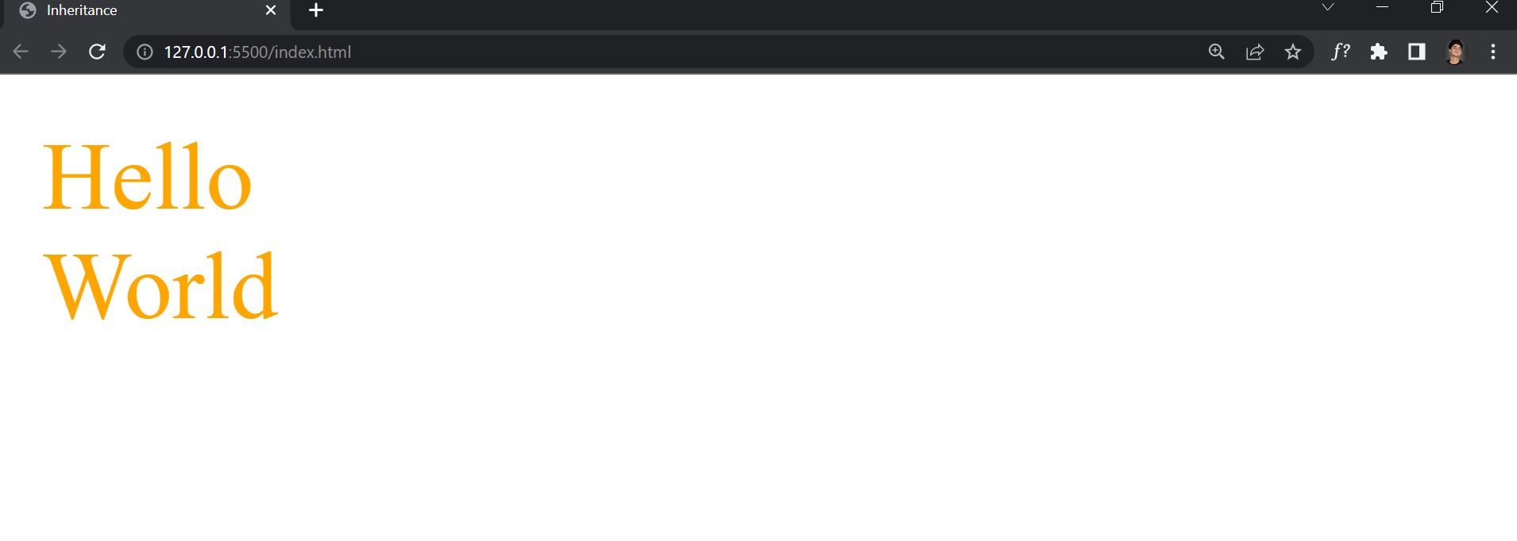

Slide 4
Not “everything” is inherited

Slide 5
Typography

Slide 6
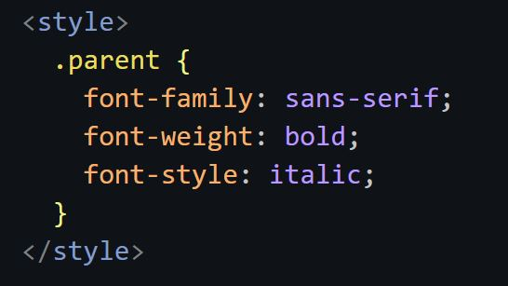
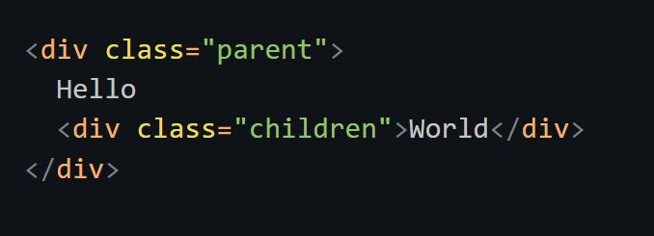
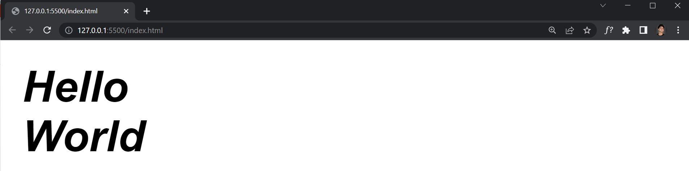

Slide 7
LAYOUT

Slide 8
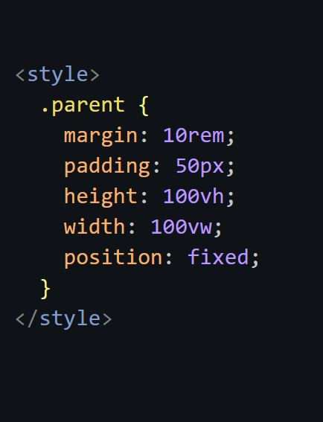
X

